Slide 1
Desirable Neighborhoods in San Francisco
Vien Nguyen March 15, 2019

Slide 2
Introduction
A couple is moving into San Francisco, and they would like to pick their neighborhood based on several factors. They want to be close to:
nearby parks
Restaurants
public transit
They would also like the adjacent neighborhoods to be desirable as well.

Slide 3
Problem
Can we build a model to recommend a neighborhood for the couple to live in, based on their specified criteria?
Target audience: couples that value living near parks, food, and transit in the city of San Francisco

Slide 4
Data Acquisition
GeoJSON file available on DataSF
San Francisco Neighborhoods as designated by the San Francisco Association of Realtors (SFAR) in August 2010
FourSquare API
Venues

Slide 5
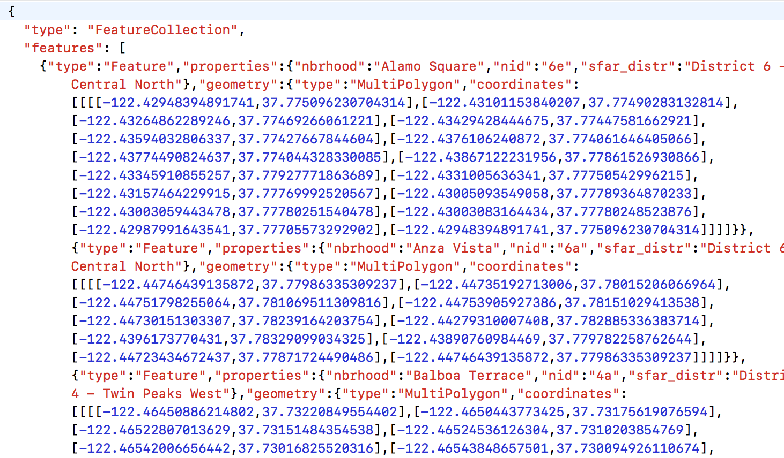
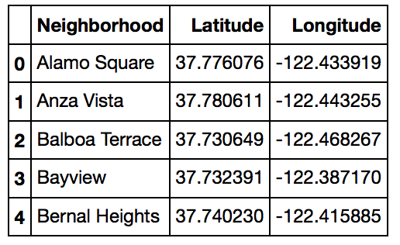
Data Cleaning
GeoJSON file
Parsed into Pandas dataframe
Shapely used to determine center
Neighborhood Name, Latitude, Longitude

Slide 6
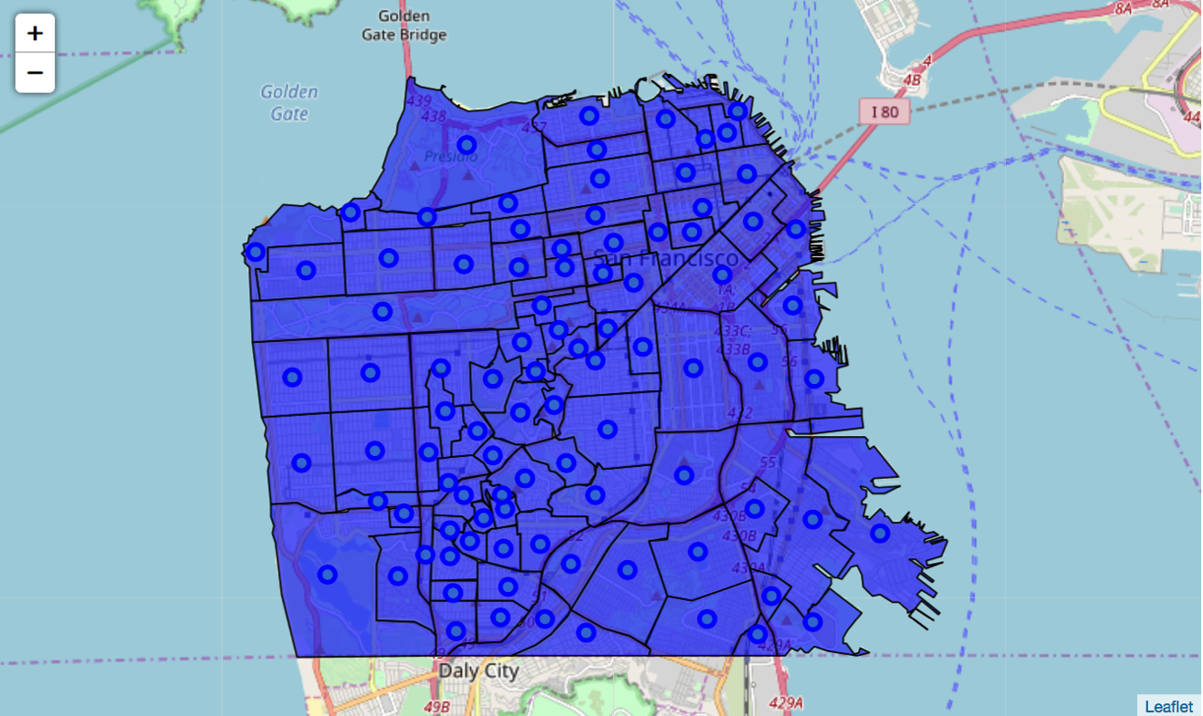
San Francisco Neighborhoods

Slide 7
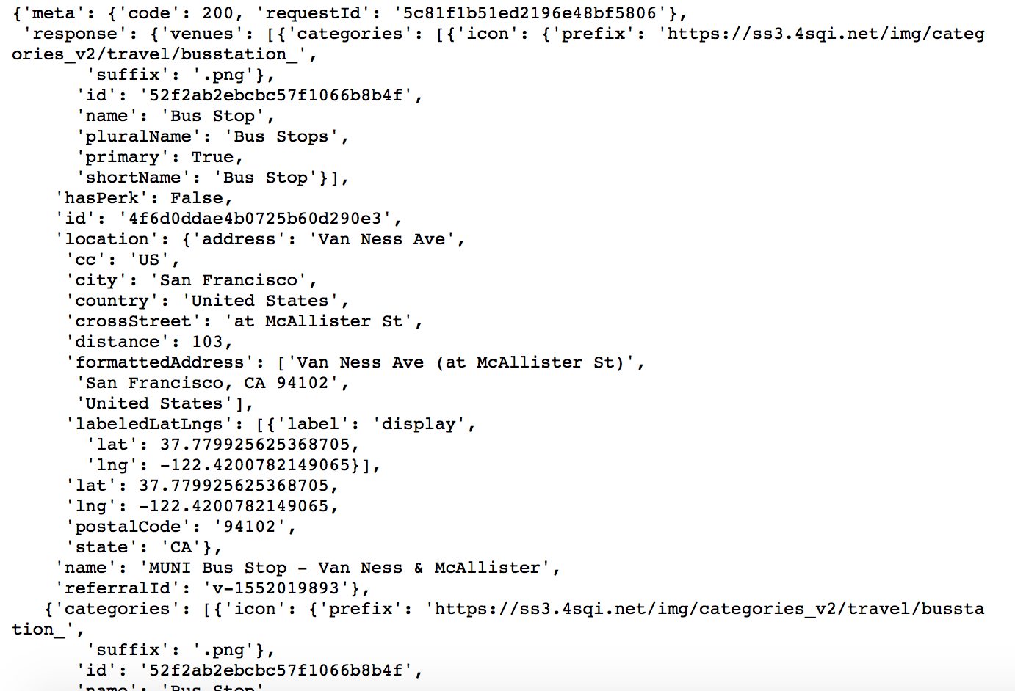
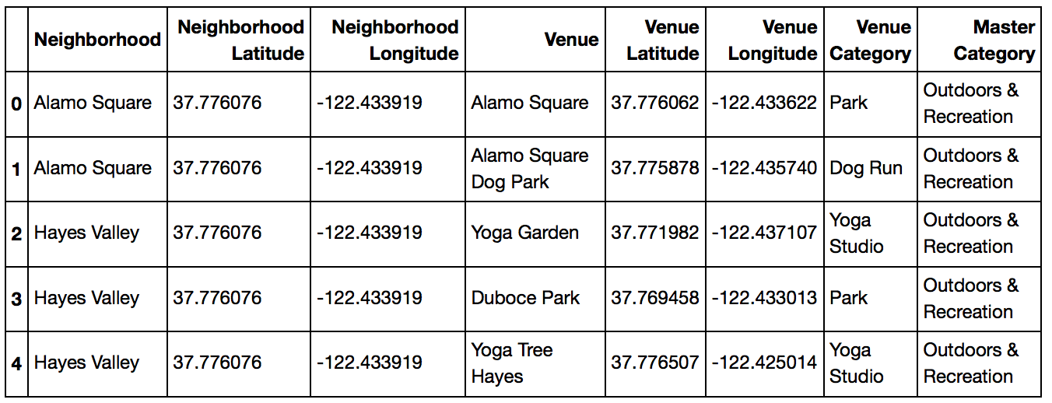
Foursquare API
Venue data
Name
Category
Latitude
Longitude

Slide 8
Foursquare API Limits
50 results maximum per call
To get around this, I made API calls for specific categories:
Arts & Entertainment 4d4b7104d754a06370d81259
Food 4d4b7105d754a06374d81259
Outdoors & Recreation 4d4b7105d754a06377d81259
Shop & Service 4d4b7105d754a06378d81259
Transit
Bus Station 4bf58dd8d48988d1fe931735
Bus Stop 52f2ab2ebcbc57f1066b8b4f
Cable Car 52f2ab2ebcbc57f1066b8b50
Light Rail Station 4bf58dd8d48988d1fc931735
Metro Station 4bf58dd8d48988d1fd931735
Train Station 4bf58dd8d48988d129951735
Tram Station 52f2ab2ebcbc57f1066b8b51

Slide 9
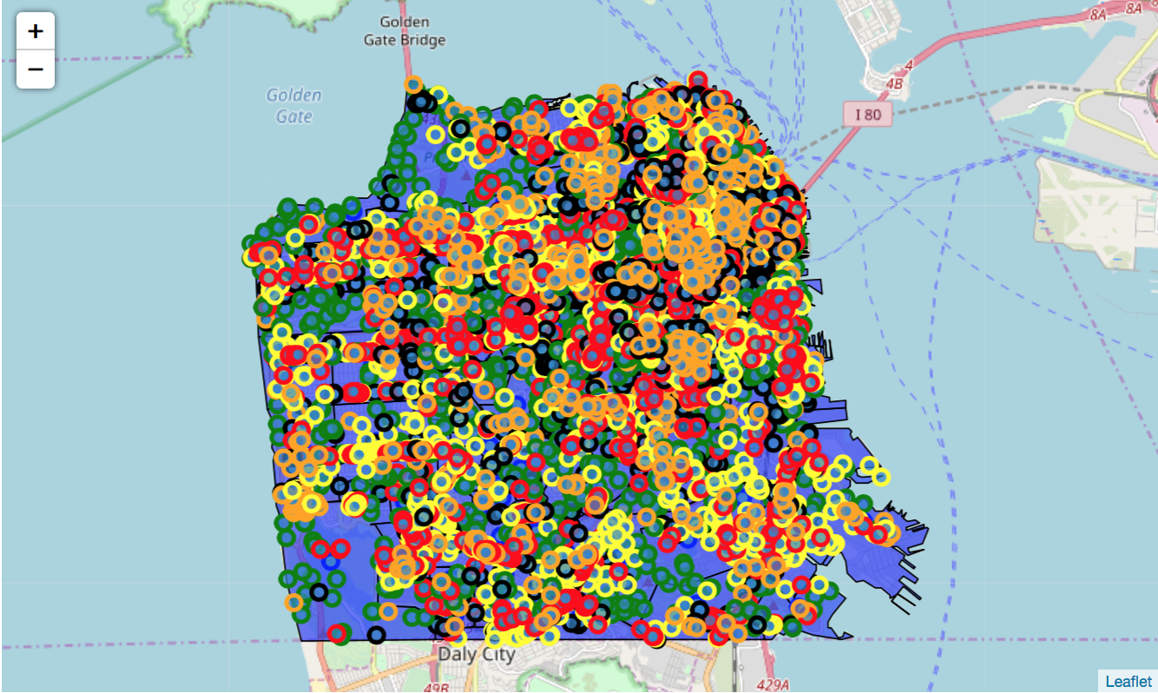
Venues around SF
Results combined for 500m and 2000m radii

Slide 10
Data Processing
After removal of duplicates:
8,923 unique venues
Outdoors & Recreation: 1523
Food: 2063
Transit: 1823
Arts & Entertainment: 940
Shop & Service: 2574

Slide 11
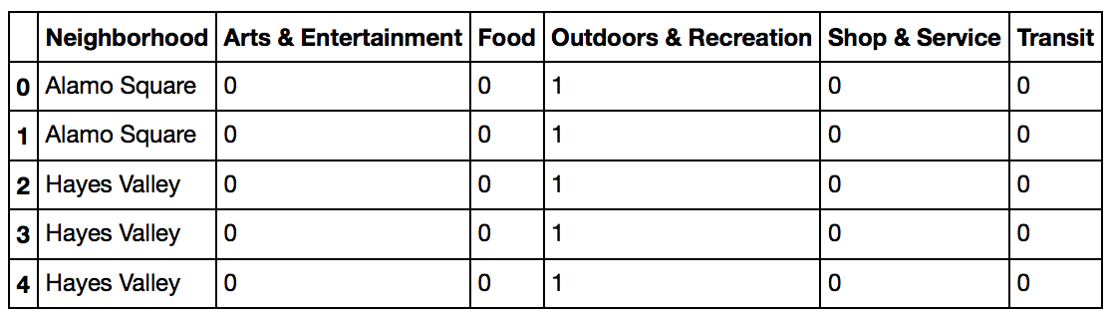
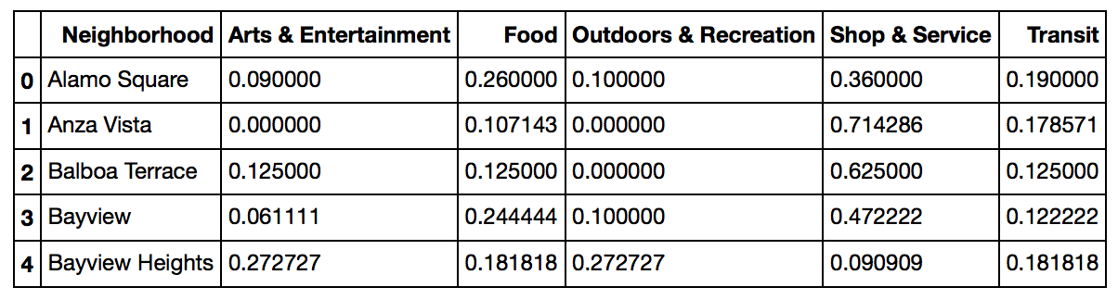
Feature Selection
One-hot encoding method
Determines proportion of each category of total venues

Slide 12
Exploratory Data Analysis
Choropleths of each category
K-means clustering
Groups similar neighborhoods based on features
Ranked score
Each category is weighted
Average Adjacent score
Mean of Ranked Score for all surrounding neighborhoods

Slide 13
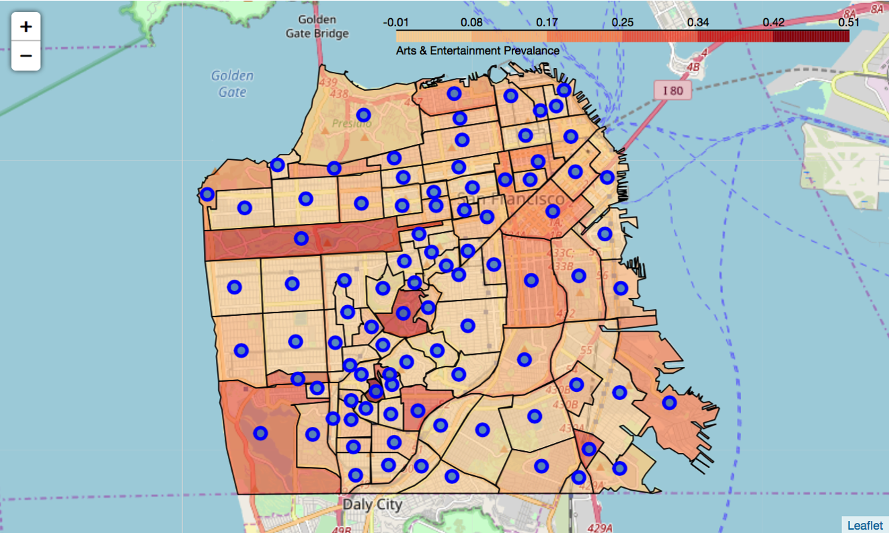
Arts & Entertainment Prevalence
Monterey Heights, Midtown Terrace, and Golden Gate Park

Slide 14
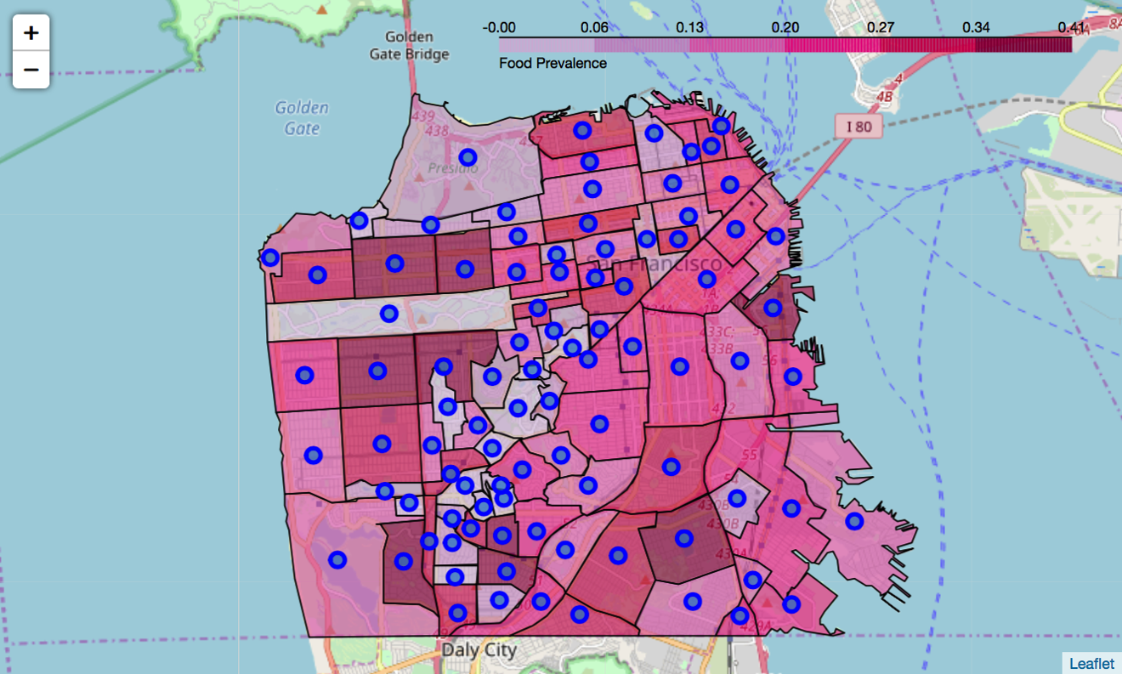
Food Prevalence
Central and Inner Richmond, Central and Inner Sunset, Portola, Mission Bay, Stonestown, Westwood Park, and Ingleside

Slide 15
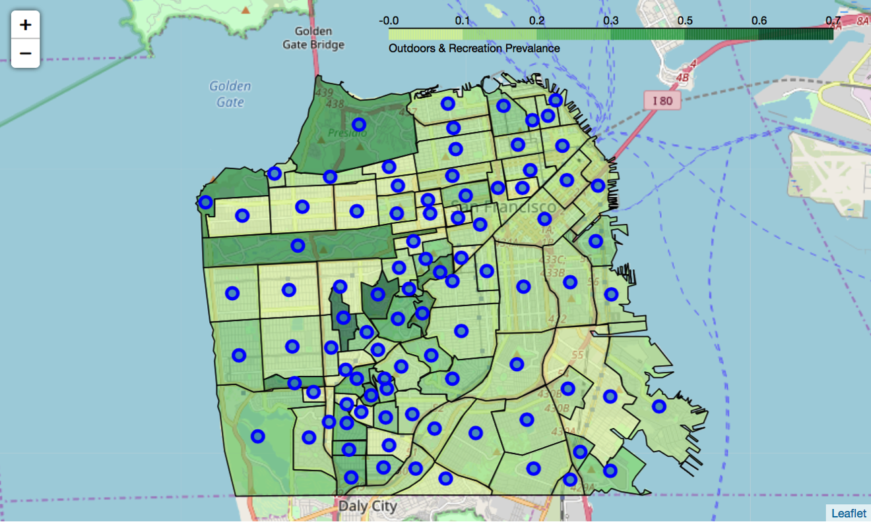
Outdoors & Recreation Prevalence
Forest Knolls and Golden Gate Heights

Slide 16
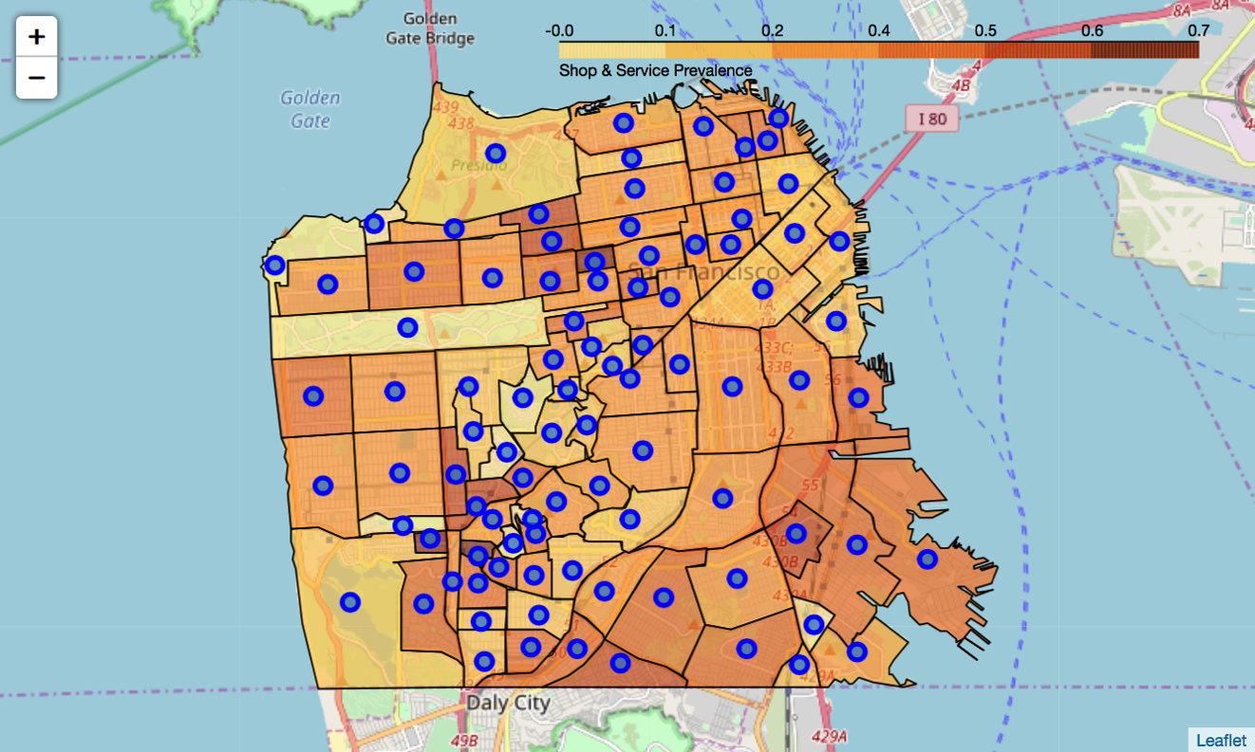
Shop & Service Prevalence
Anza Vista, Balboa Terrace, and Merced Manor

Slide 17
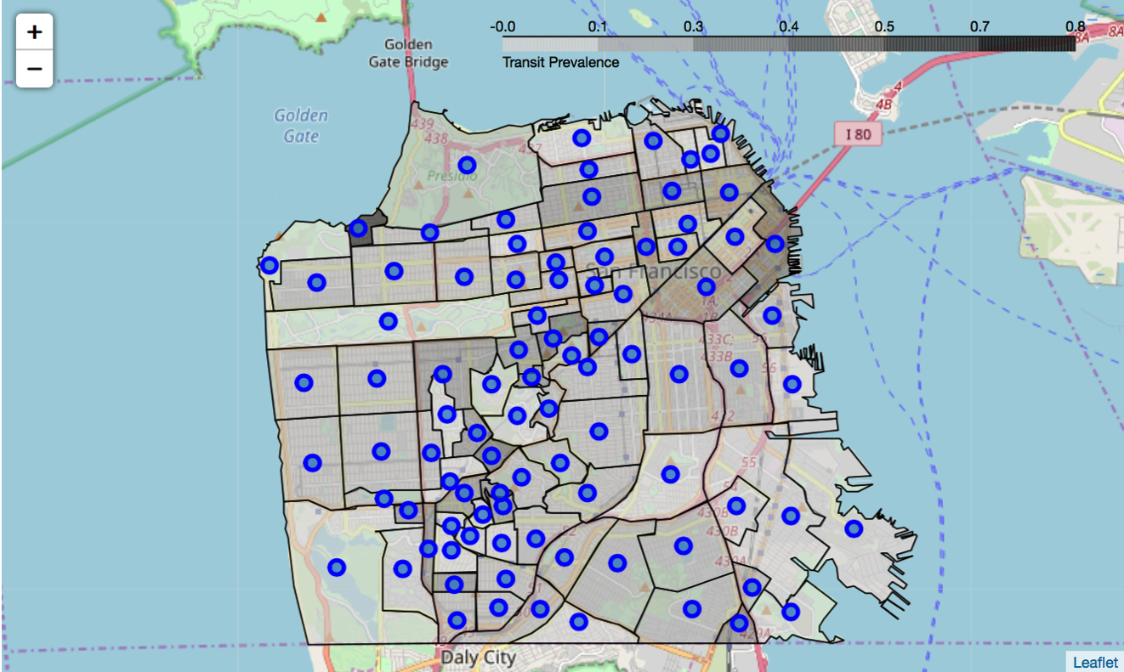
Transit Prevalence
Sea Cliff

Slide 18
k-means Clustering
This method works by initially randomly placing cluster centroids within the points of the feature set. It then calculates the distance between the centroid and all other points. After each iteration, it moves the centroid closer to the features and recalculates the distances. After enough iterations, the distances between the feature points and the centroids has been minimized enough to consider all the points within a cluster as related.

Slide 19
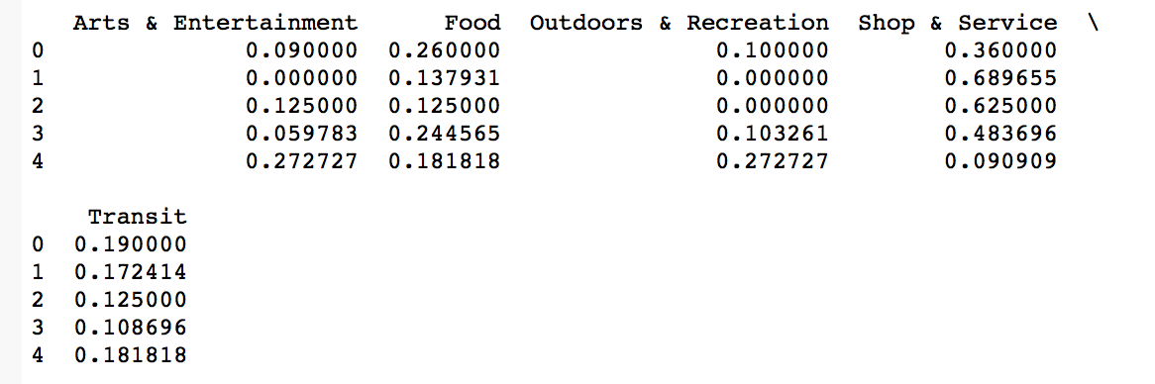
k-means Clustering
By using k-means clustering, we group like neighborhoods together based on the values of the five categories.
We can eliminate clusters 1 and 2 due to low Outdoors & Recreation

Slide 20
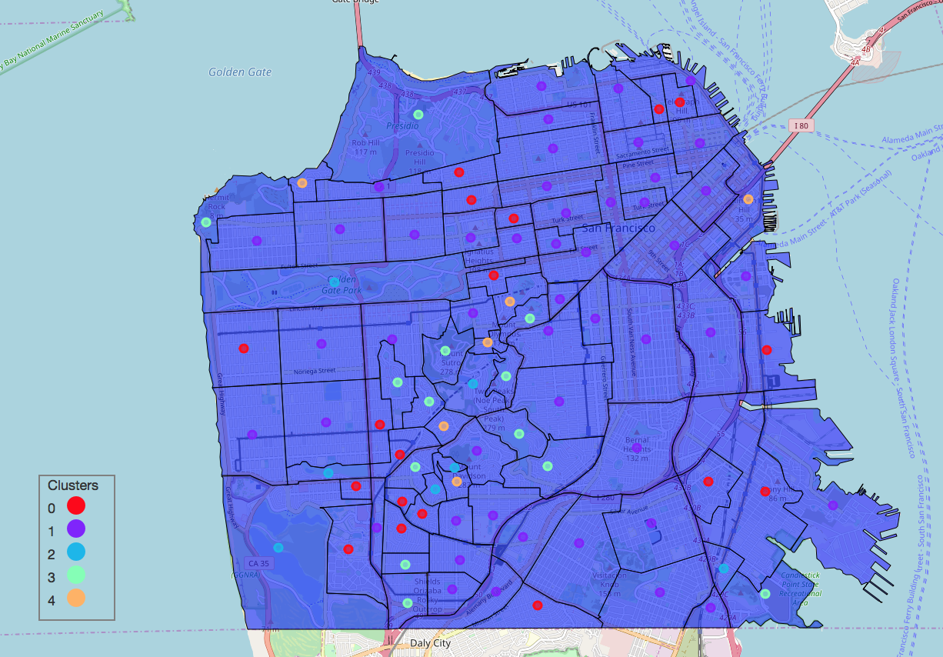
SF Neighborhoods Clustered

Slide 21
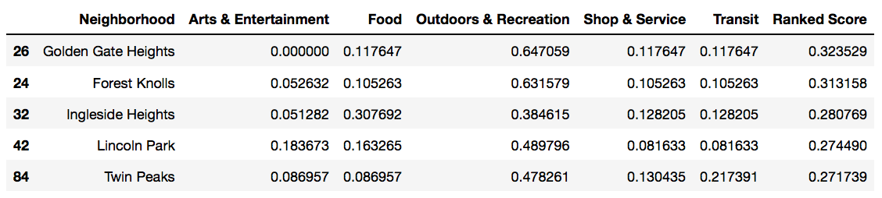
Primary Target Variable
Ranked Score
40% Outdoors & Recreation
30% Food
20% Transit
5% Arts & Entertainment
5% Shop & Service

Slide 22
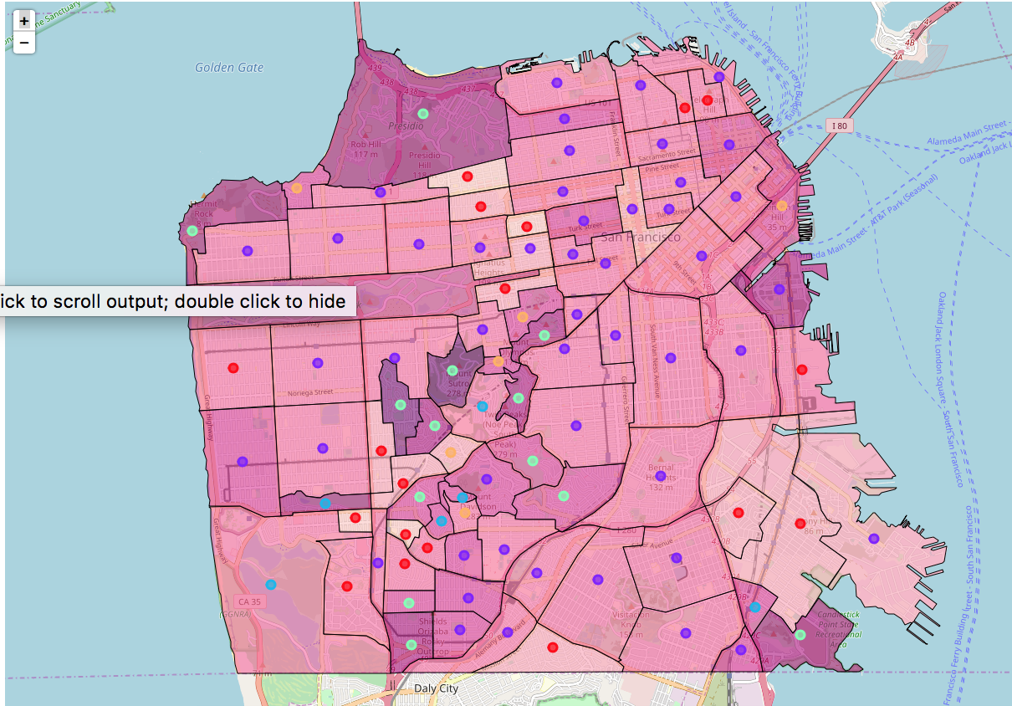
Choropleth of Ranked Score
Note: Clusters are from previous map

Slide 23
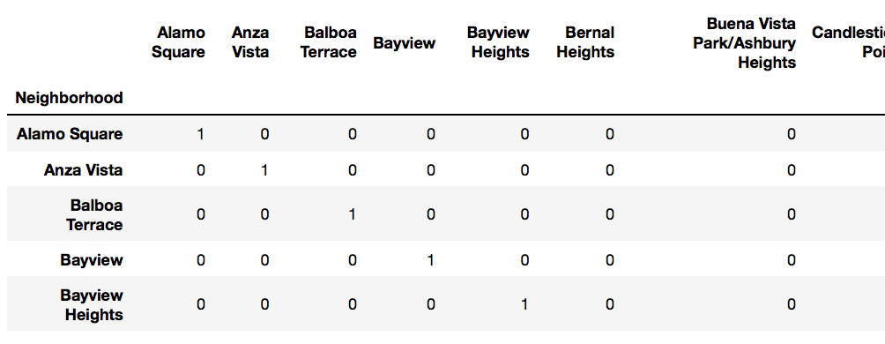
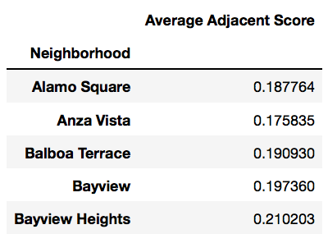
Secondary Target Variable
Average Adjacent Score
Average of Ranked Score for all neighborhoods touching that neighborhood
One-hot encoding of whether neighborhoods touch

Slide 24
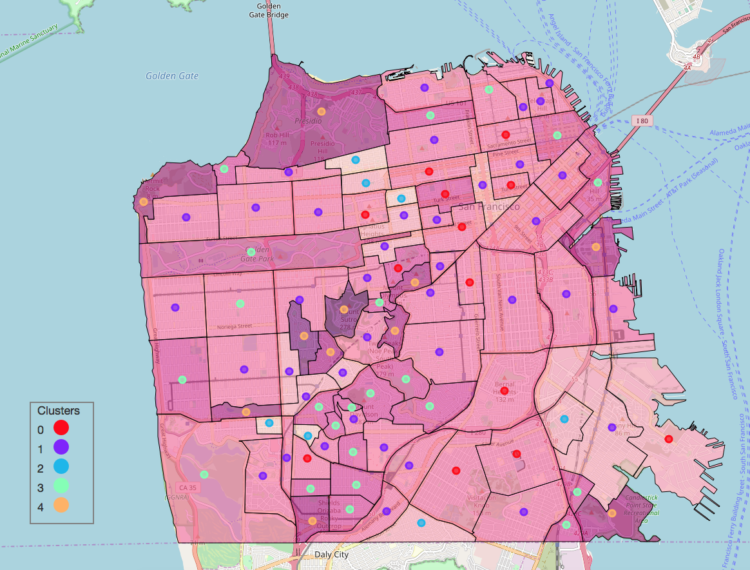
Clustered by Ranked Score

Slide 25
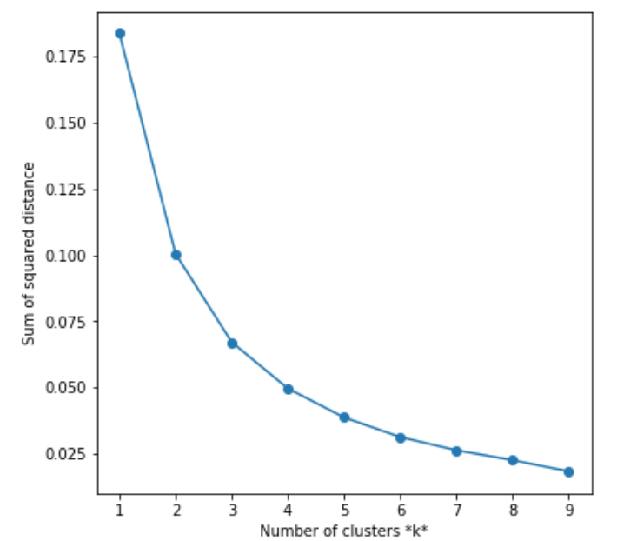
Evaluation of k
Elbow method
No clear elbow
k=5 is fine

Slide 26
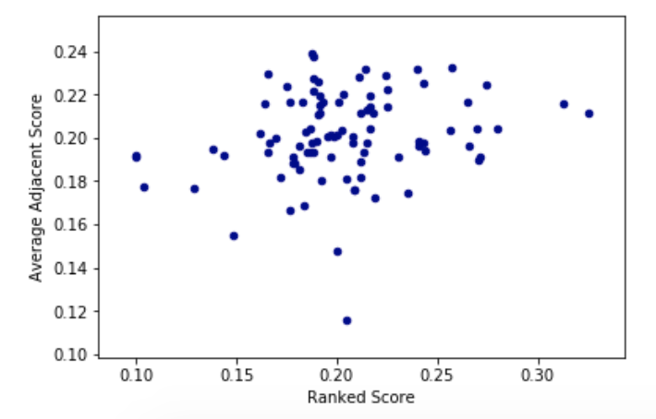
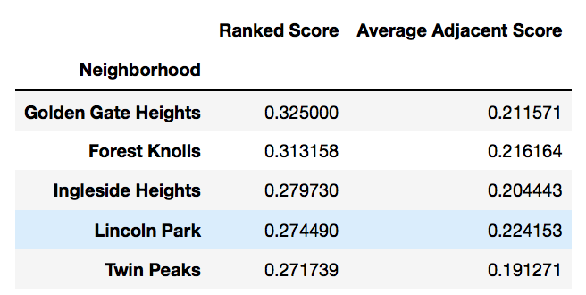
Results
Golden Gate Heights is a strongly ranked candidate

Slide 27
Discussion
Clear recommendation based on the weights given by the target audience.
Grouping of similar neighborhoods by features
Limitations:
Foursquare API may exclude some venues
Search of each area could be more extensive
Other venues such as government, hotels could be added to the analysis
Number of venues can be used in a future analysis

Slide 28
Conclusion
Using GIS data from DataSF and the venue data from Foursquare, I was able to determine which neighborhood would be desirable for a target audience that has a preference for Outdoors & Recreation, Food, and Transit.
By using k-means clustering, I could group similar neighborhoods, which allows me to eliminate less desirable neighborhoods from the final recommendation.

